Slide 1
Adventure Of Chunchin
Developed By
Nayeemuzzaman (Roll-02)
Rafid Ahmed (Roll-23)

Slide 2
Project outline
Objectives
Gameplay
Features
Flow Chart
User Friendliness
Resources

Slide 3
Objectives
Use C++ to implement softwares using media layer softwares
Learn modular programming
Learn the use of C++ in animating and creating games

Slide 4

Gameplay(intro)
When you start the game, at first the logo will be displayed. You can skip it by pressing Enter

Slide 5
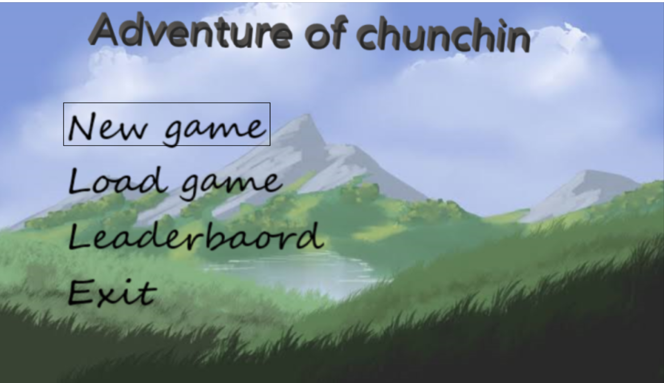
Gamplay(menu)
After that, menu will be displayed. You can select any of them using mouse or keyboard

Slide 6
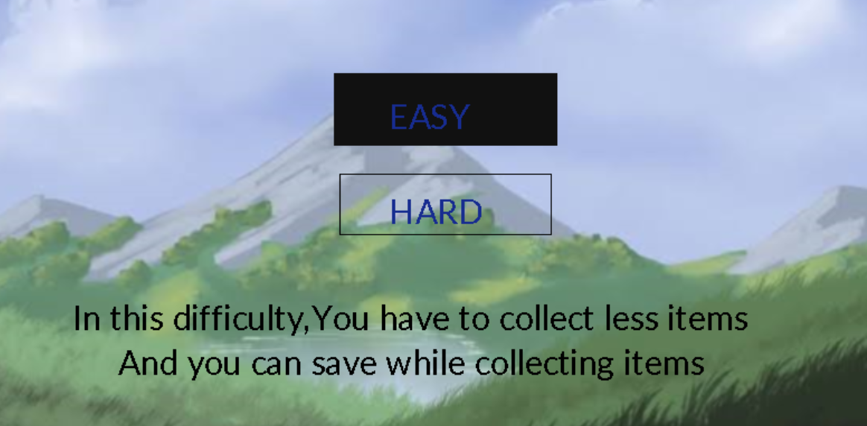
gAmeplay(new game)
After you select new game, you’ll be given basic instructions and after that , you’ll have to select if you wanna play it in easy mode or hard mode

Slide 7
GAmplay
There are 4 places in the game . They are:
Land of oppurtunities.
Liberty city.
Asgard.
Deadman Wonderland.
There are a total of 5 stages.
All places except Land of oppurnity is locked at stage 1.
In each of first 4 stages you have to talk with 1 person and do some tasks(collecting items) for them to unlock next place.

Slide 8
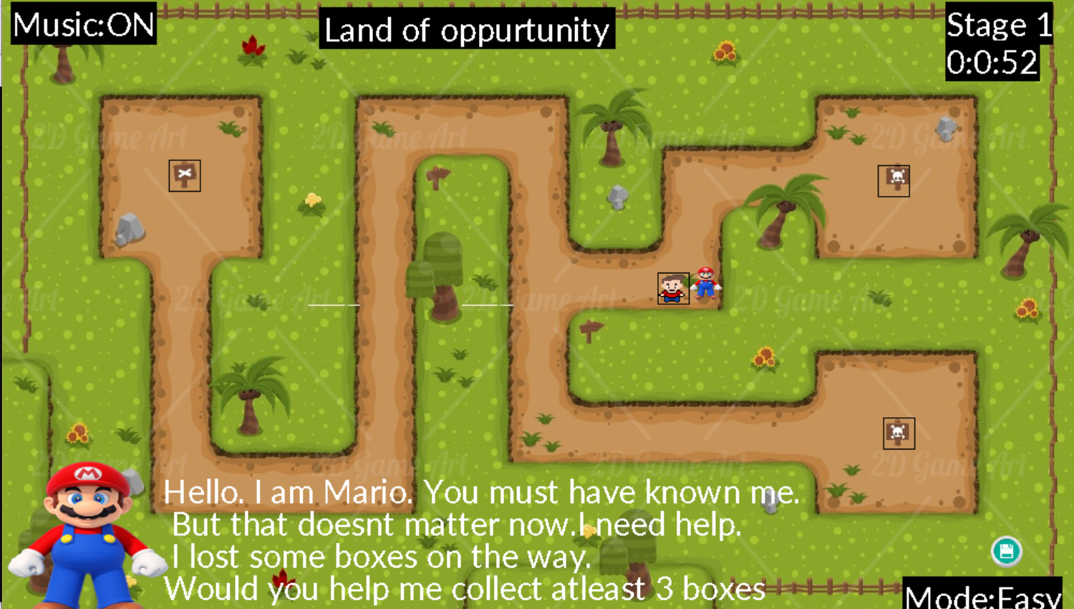
Gameplay(stage 1)
In stage 1 you have to talk with Mario and collect 3(easy) or 5(hard) boxes for him to unlock Liberty city

Slide 9
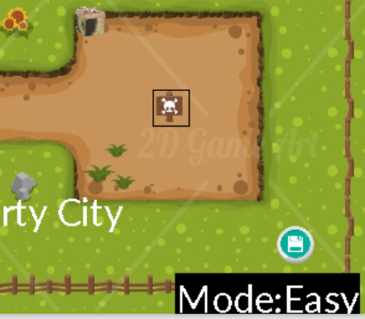
Gameplay(save feature)
You can save ant game state by clicking the save icon at the bottom left corner.

Slide 10
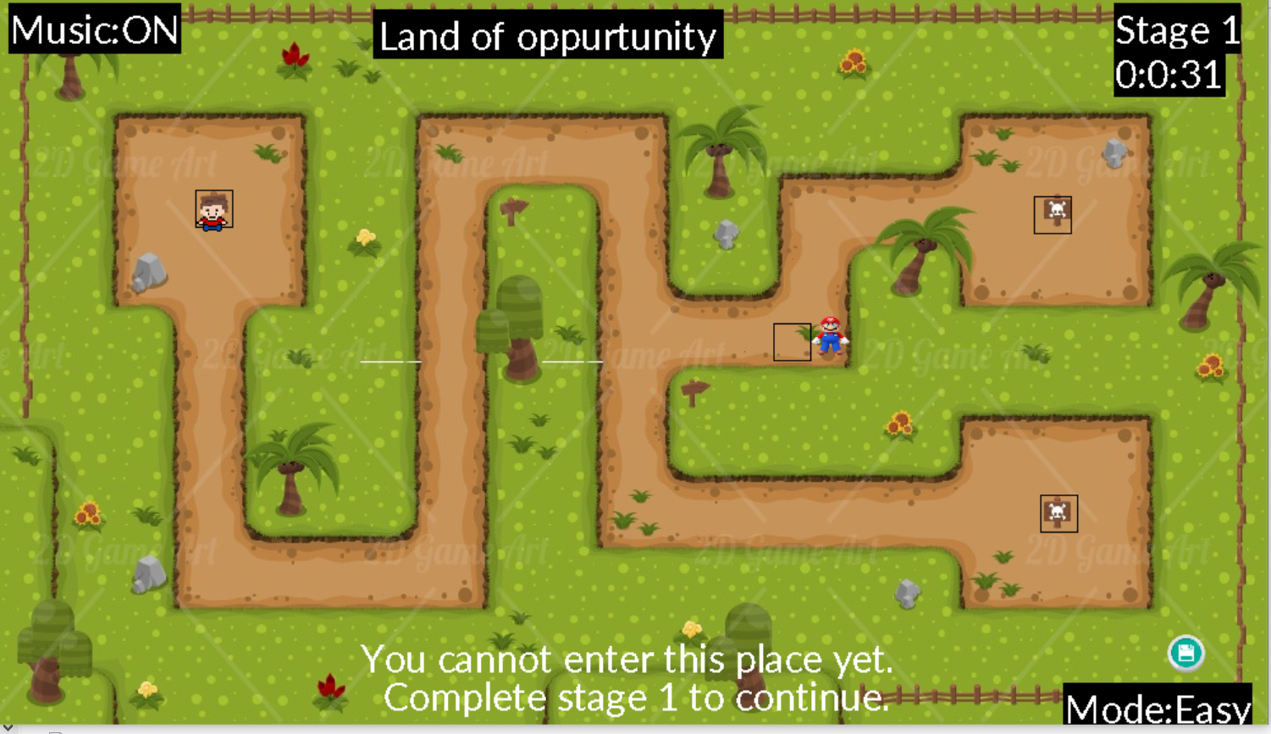
Gameplay
You cannot enter a place without completing its prerequisites.

Slide 11
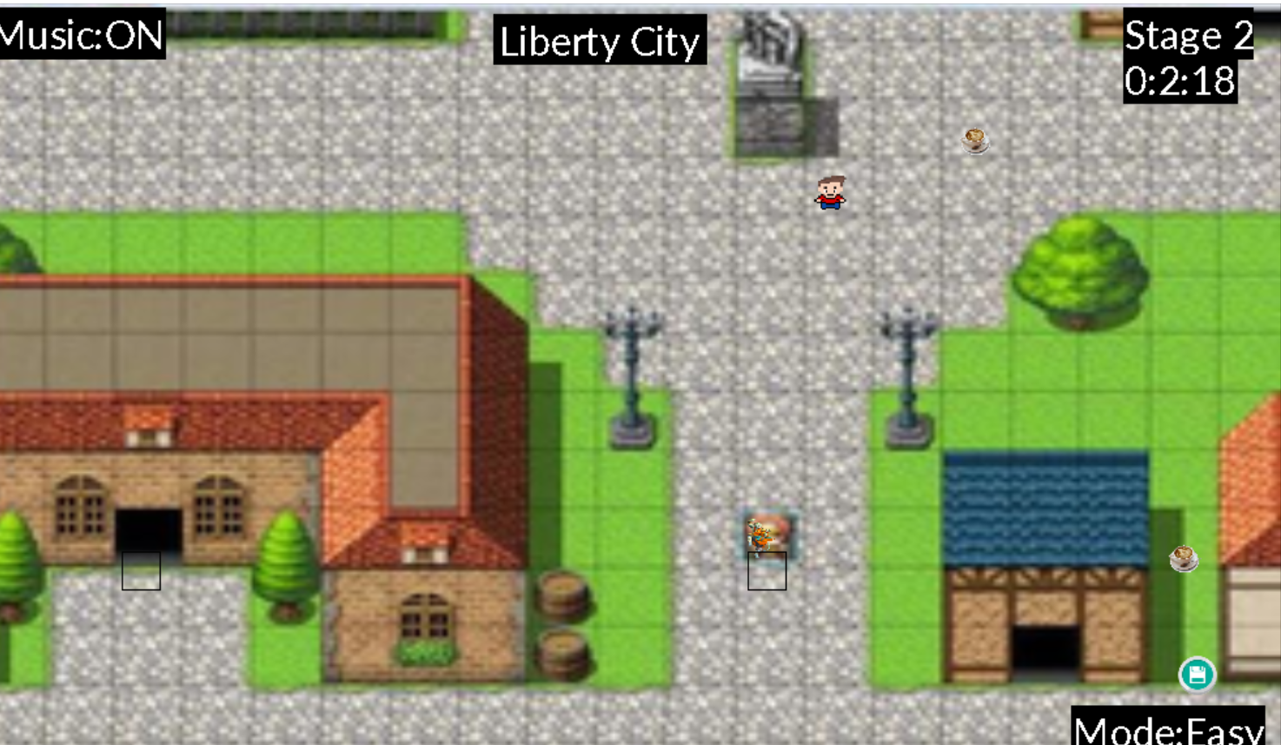
Gameplay(stage -02)
In stage 2 you have to talk to an unknown person and help him in order to obtain the key to Asgard.

Slide 12
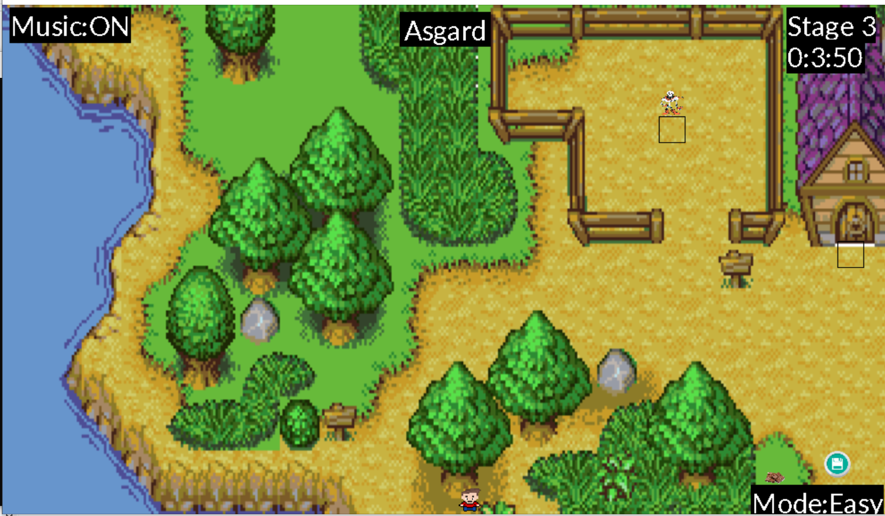
Gameplay(stage-03)
In stage 3 you have to meet with Papyrus and do the task in order to get to Deadman Wanderland .

Slide 13
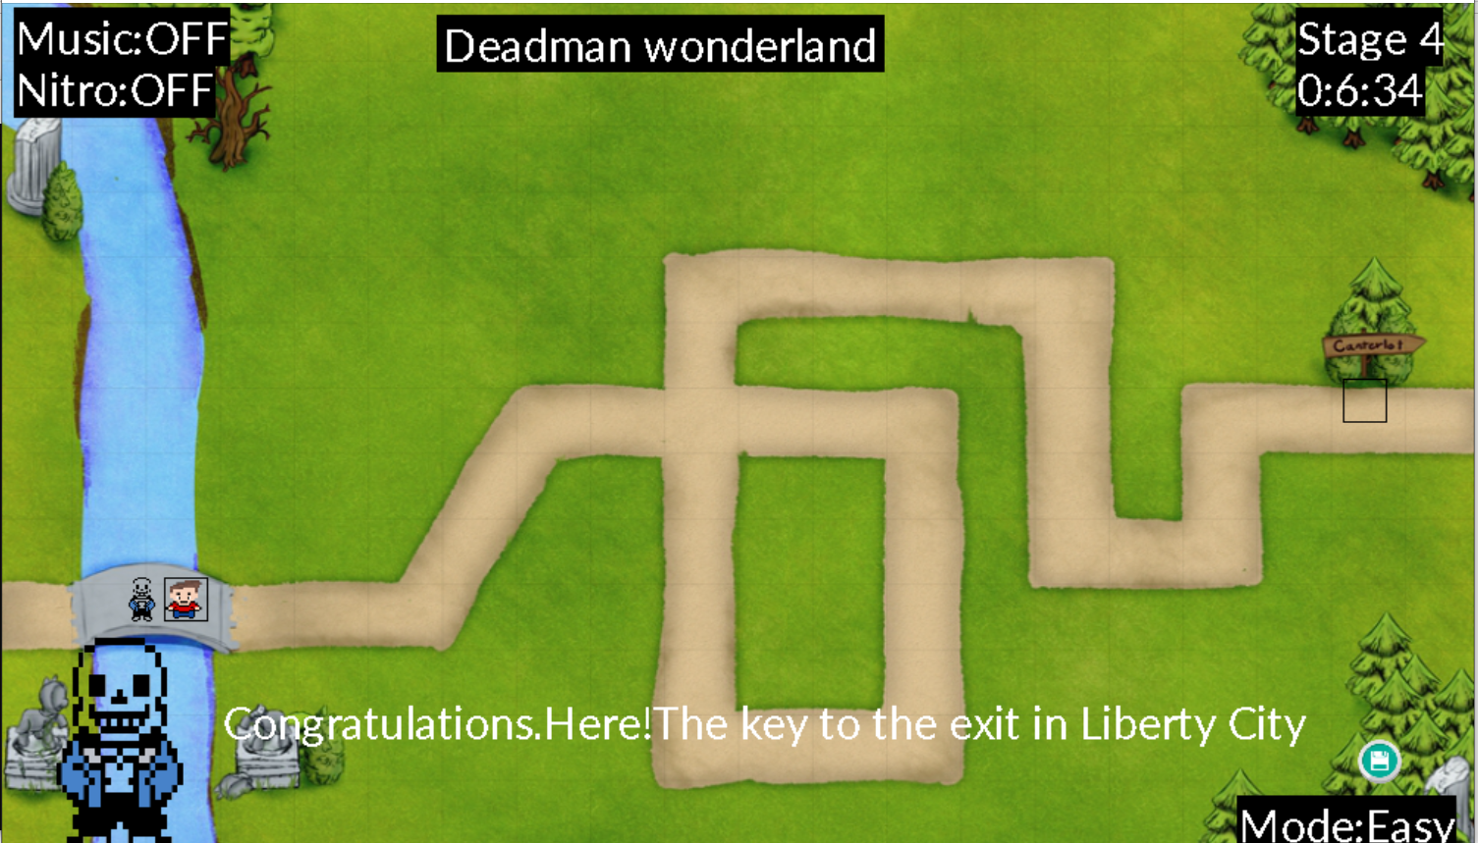
Gameplay(stage-04)
In stage 4 you have to meet with Sans. Completing his given task will give you the key to exit Liberty city.

Slide 14
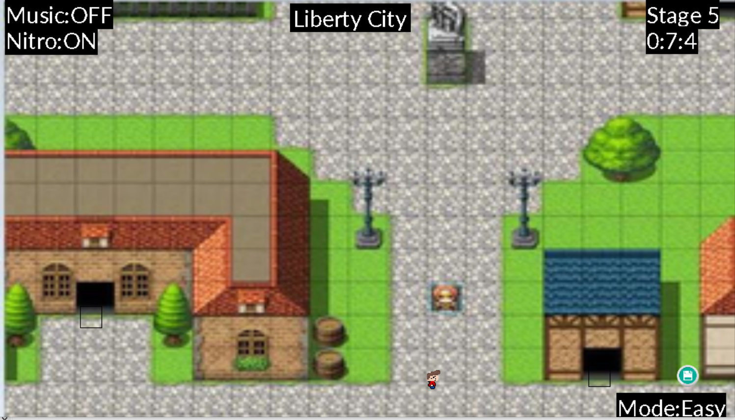
Gameplay(stage-05)
In stage 5 you have to get back to Liberty City and exiting the hall will finish the game.

Slide 15
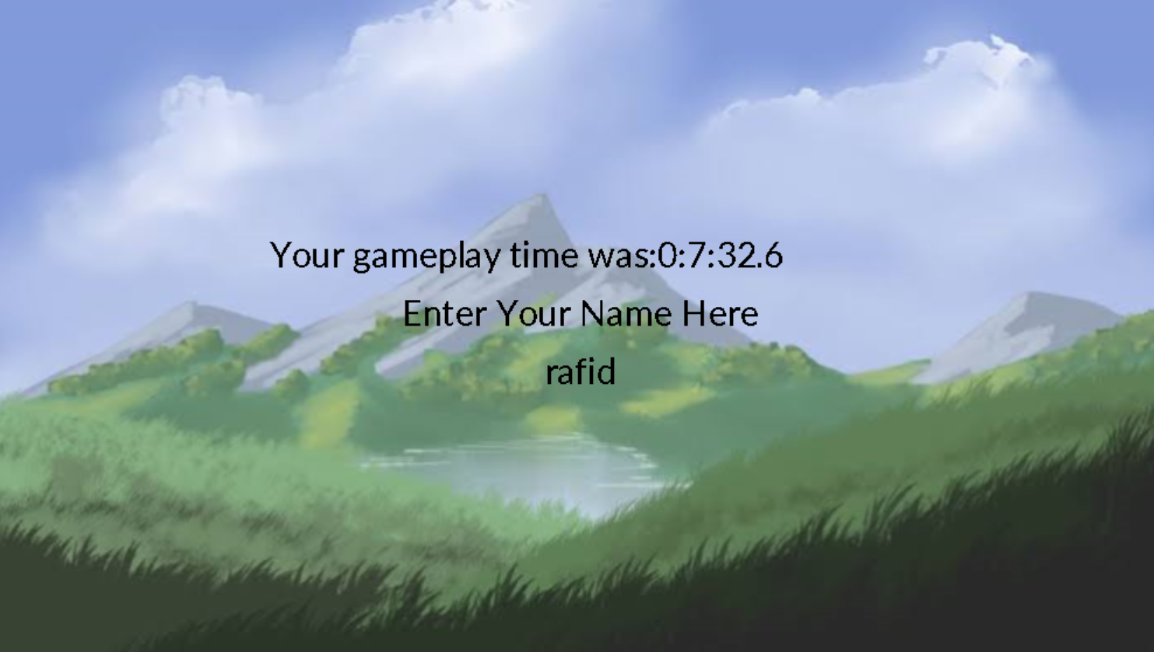
Player’s name
After finishing the game you have to give your name and your name will go to the leaderboard.

Slide 16
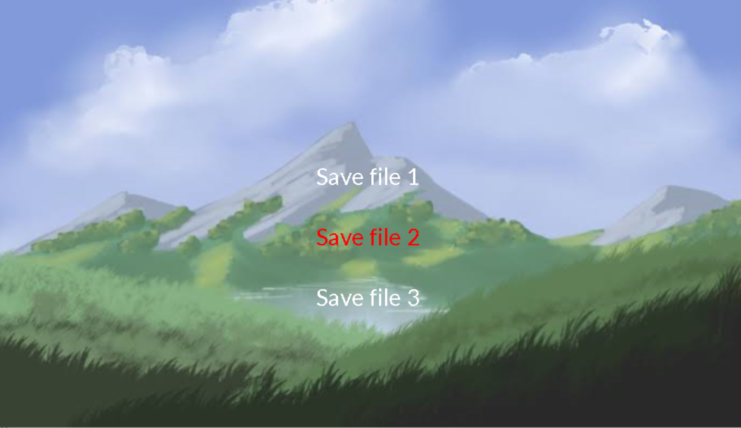
LoadGAme

Slide 17
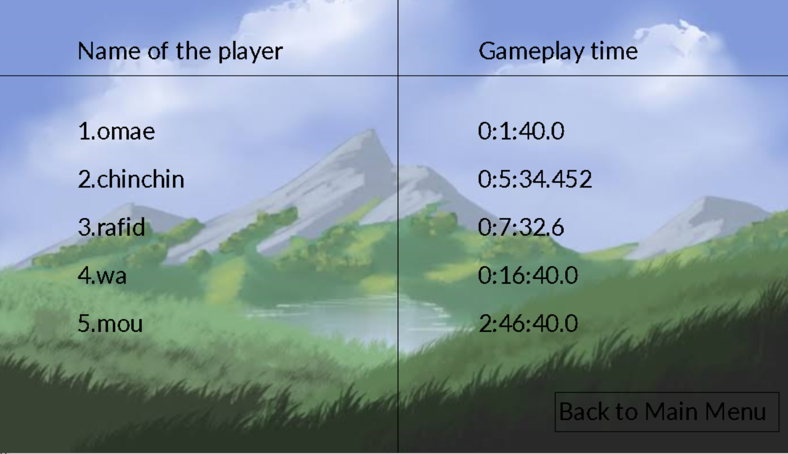
Leaderboaed

Slide 18
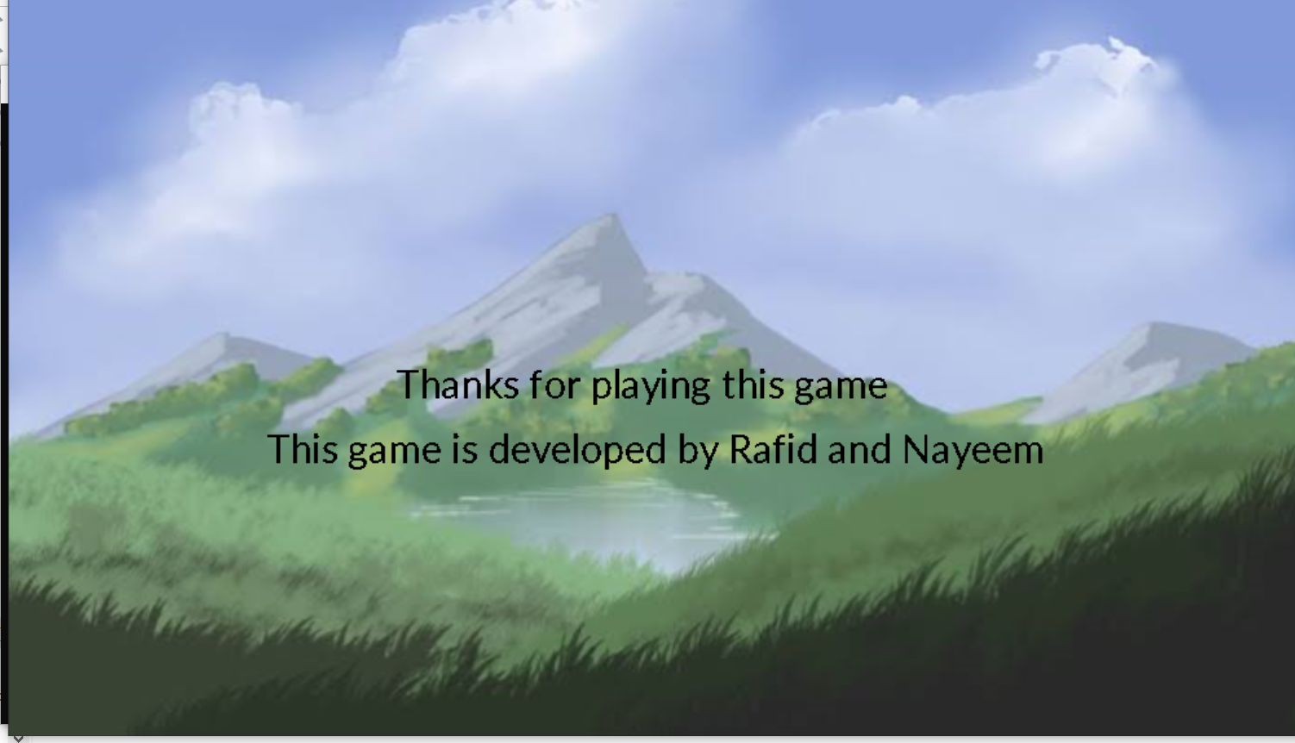
Exit and credits
After finishing the game credits are shown and that’s the end of gameplay part.

Slide 19
features
There are 2 difficulties. In hard one you have to collect more items at each stage and you cannot save game during the collection, both of which are available in easy mode.
There are 3 save slots which you can use to save any state of gameplay
Pressing H will give you help instructions if you are confused
There are lots of sound effects and musics to make gameplay more enjoyable.
Pressing M will turn on and off music
Pressing N will give you nitro shoes(after you talk with sans at stage 4)
Press and hold Left Shift to run faster

Slide 20

Flow chart of source code
Module 1(m1)
int main()
talk
intro
Collect items
talk
menu
New game
Load game
Leaderboard
Exit
Exit game
Basic instructions
Select savefile
Show scores
Set new leader
baord
Input name of player
Loads data
Set difficulty
credits
reset()
Stage 1
Stage 4
m1
Stage 5
checks data
m1
m1
move char
render environment
Stage 2
m1
Stage 2
Check states
Save?
Saves states on savefile

Slide 21
User friendliness
Both keyboard and mouse can be used to select options
You can revert back from
Gameplay to main menu(with a warning of usaved progress being deleleted)
Load game menu to main menu
Leaderbaord to main menu
Basic instruction or difficulty settings to main menu
You can skip intro, basic instructions quick
Fast running and nitros are given to play fast paced for impatient players

Slide 22
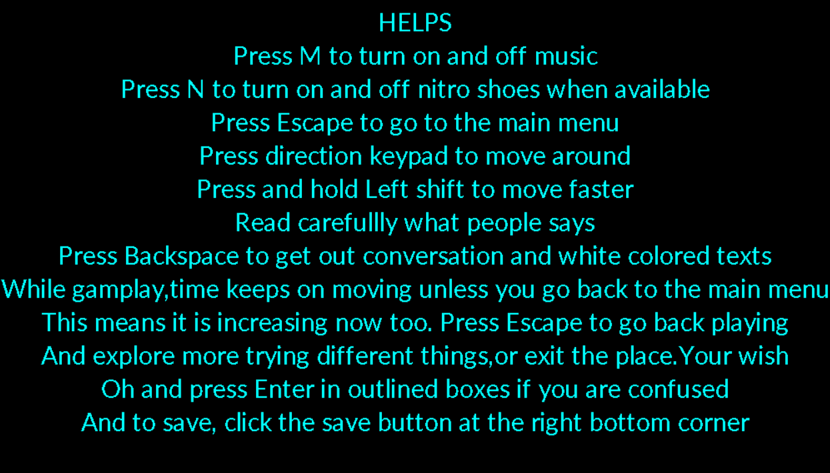
User friendliness
Pressing H during gamplay will display the following , which can be helpful to the players to get through the game.

Slide 23
resources
The entire code was written in sumblime text editor and compiled using terminal in Ubuntu
After completing the project. Visual studio c++ was used to build an executable file of it.
The media (musics,sound effects and pictures) used here are not owned by us. The media credits goes to Doki Doki Literature Club, Undertale,Super smash bros. and random googlings.

Slide 24
Thank you everyone for giving us some of your time

